Slide 1
Media Briefing
November 9, 2021
Notes:
Good afternoon. Thank you all for taking time out of your day to join us here.
My name is Chris Day and I am National Spokesperson for Canada Food Facts for Consumers (C3FC).
Yesterday we officially launched a new grassroots group that has been in the making for some time. Today we wanted to take a few minutes to share our story about who we are, why we have been created and what we intend to do. So let’s get started.

Slide 2
Our Mission Statement
We want to ensure that consumers have the facts about the food that they buy and eat. Our goal is to demonstrate that Canadian agriculture and agri-food is world-class, sustainable, healthy and delicious. We are going to stand up for the hard-working men and women that grow, produce and manufacture high-quality food products. We aren’t going to let misinformation, unscientific and agenda-driven myths stand. In achieving our mission, we will support jobs and prosperity for Canadians in every region of the country.
Notes:
I’m going to begin with our Mission Statement (READ IT)

Slide 3
Who We Are
We are consumers who love Canadian grown and made food and we want to promote it here at home and around the world.
We want to ensure Canadians have the real facts about Canadian agriculture and agri-food.
We want to put science, rules and reliable information in the hands of consumers, governments, media and other stakeholders.

Slide 4
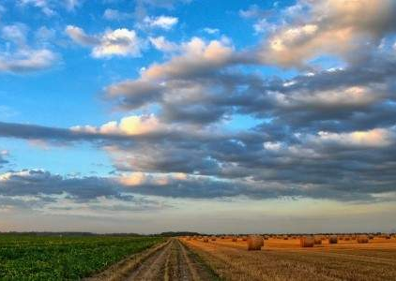
Why We Exist
Canada’s agriculture and agri-food sector is under attack from agenda-driven activists, attention-seeking individuals who distort truth to fit their ambition, indifferent policy-makers, and others either actively working against Canadian agriculture or simply not recognizing the valuable contributions it makes to prosperity in every region and to every kitchen table across the country.
Consumers are caught in the cross-fire.
We cannot let these voices silence the truth. We have a world-class, responsibly regulated food system and we must counter the voices of our opponents.
By meeting these attacks head-on, we will:
Ensure consumer confidence in Canadian food
Protect and preserve Canadian jobs
Grow Canada’s agricultural footprint in global markets
Counter detractors and show we are fighting back

Slide 5
What We Will Do
First and foremost, we are a voice for consumers. We want everyday people to better understand Canada’s agriculture advantage and why Canada’s food system is world-class.
At the same time, we want be a consumer voice that supports farmers, producers, processors and manufacturers of world-class Canadian products. We are unabashedly pro-Canadian food.
We will vigorously defend Canada’s agriculture and agri-food sector here at home and abroad.

Slide 6
Sample Initiatives
Promoting Canada as a World-Class Producer of Agriculture and Agri-Food Products
Showcasing Canada as responsible partner in creating sustainable food
Ensuring Consumers have the best FACTS and INFORMATION available about the food they buy and eat
Standing up for Canadian Agri-Food against critics at home
Defending Canadian Agri-Food against critics abroad

Slide 7
How We Will Grow
We need industry groups, businesses, and individuals to support our efforts.
We need to create a united front on the issues that we agree on.
At home and abroad, we need to ensure Canada’s agriculture and agri-food sector thrives.
The post-pandemic global economy is going to be more fiercely competitive than ever before.

Slide 8
The Post-Pandemic Future is Almost Here
Key characteristics at home and abroad will include:
Consumers want to support local like never before.
People will be cooking and eating more at home.
In a “build back better” world, consumers will have questions and demand answers about their food.
If we don’t provide a voice for consumers that is pro-farmer and pro-industry, our opponents will fill the void.

Slide 9
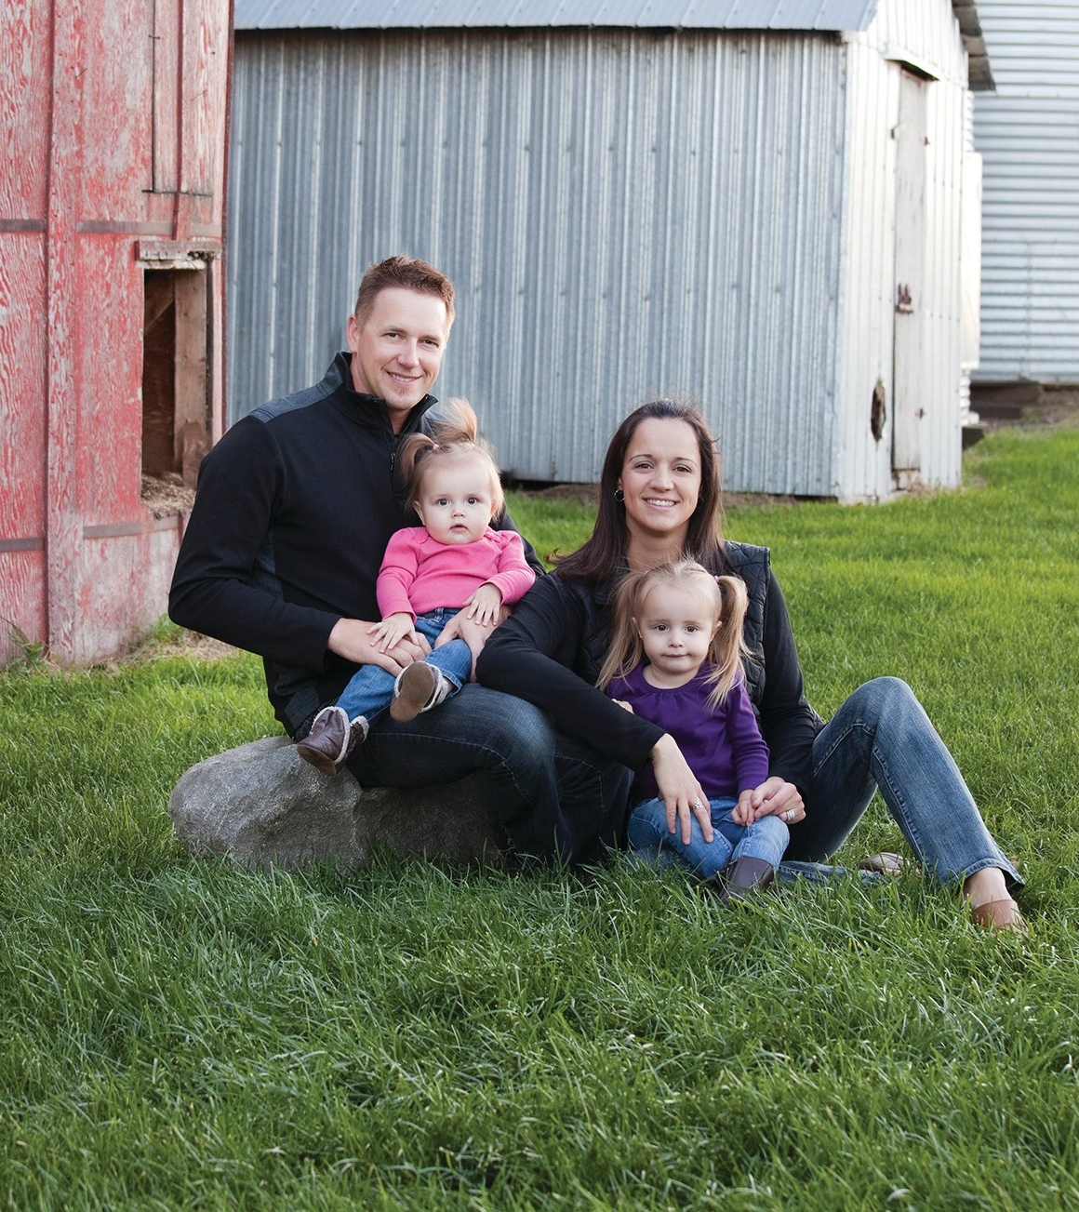
Follow us on our Journey
We need your help and support
Approach us for your stories, consider our pitches
Follow our social channels:
Twitter: @foodfaits
Facebook: /foodfaits
Instagram: @foodfaits
Let’s stand up for Canada’s Agriculture and Agri-Food Sector

Slide 10
Questions?

Slide 11
Thank-you/Merci

